Slide 1

My Implement of Adaboost
By Yu Zongxi

Slide 2
1. Boring Code

Slide 3

NO CODE ALLOWED

Slide 4
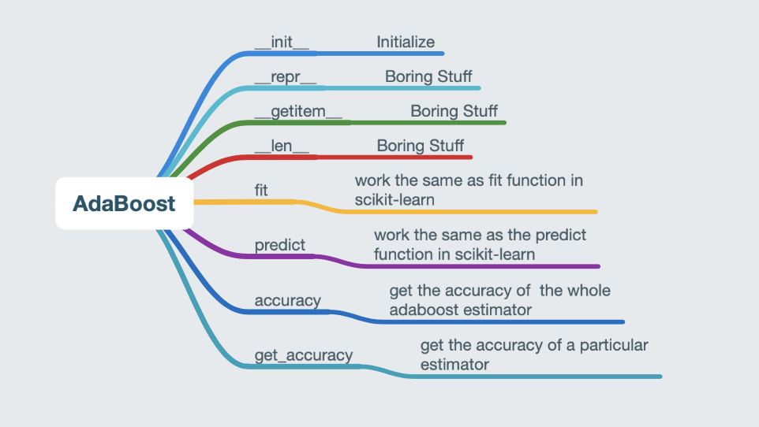
Adaboost

Slide 5
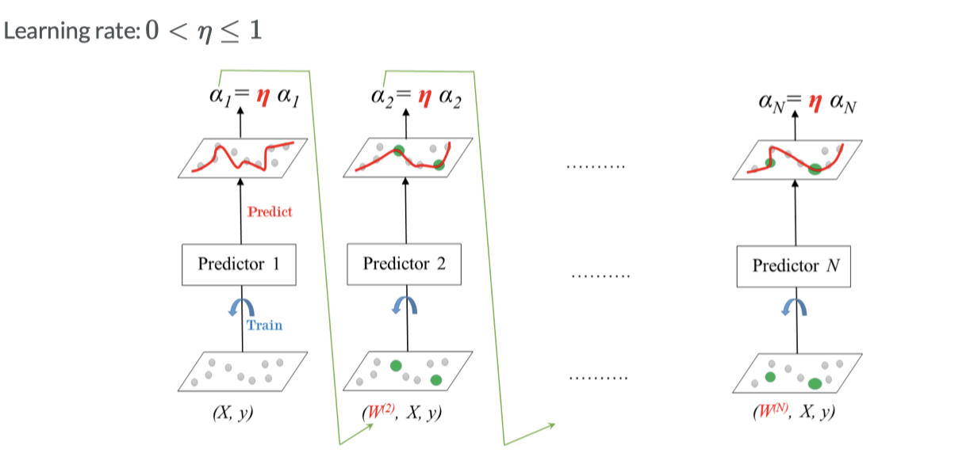

Slide 6
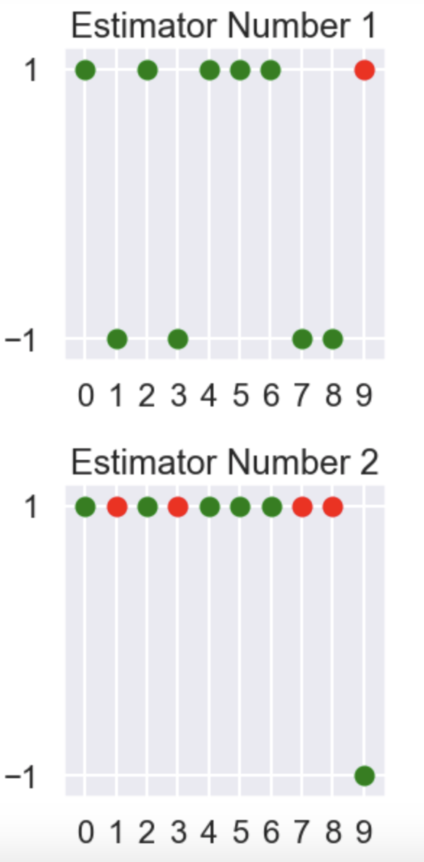
Small Detail

Slide 7
2. Conclusion

Slide 8
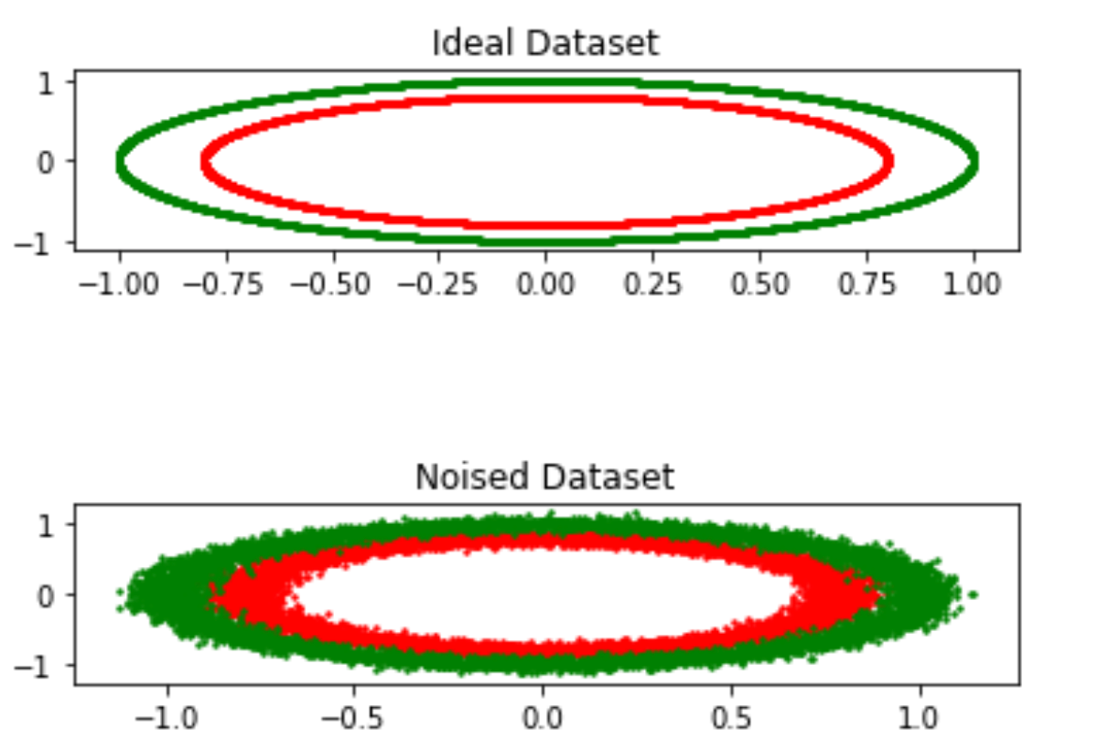
Dataset

Slide 9
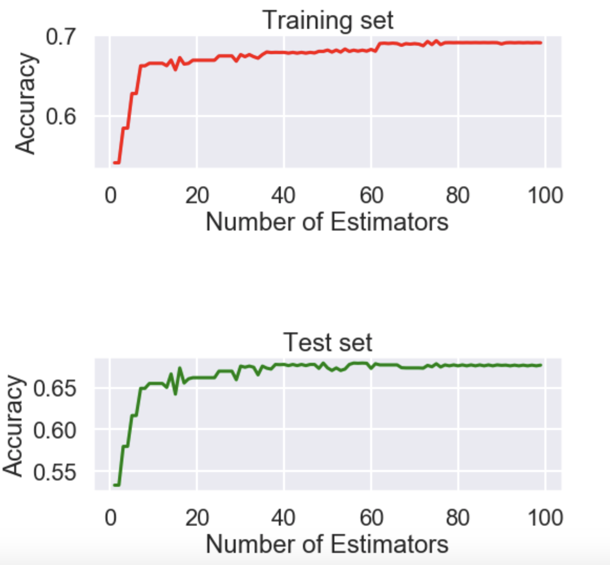
Accuracy

Slide 10
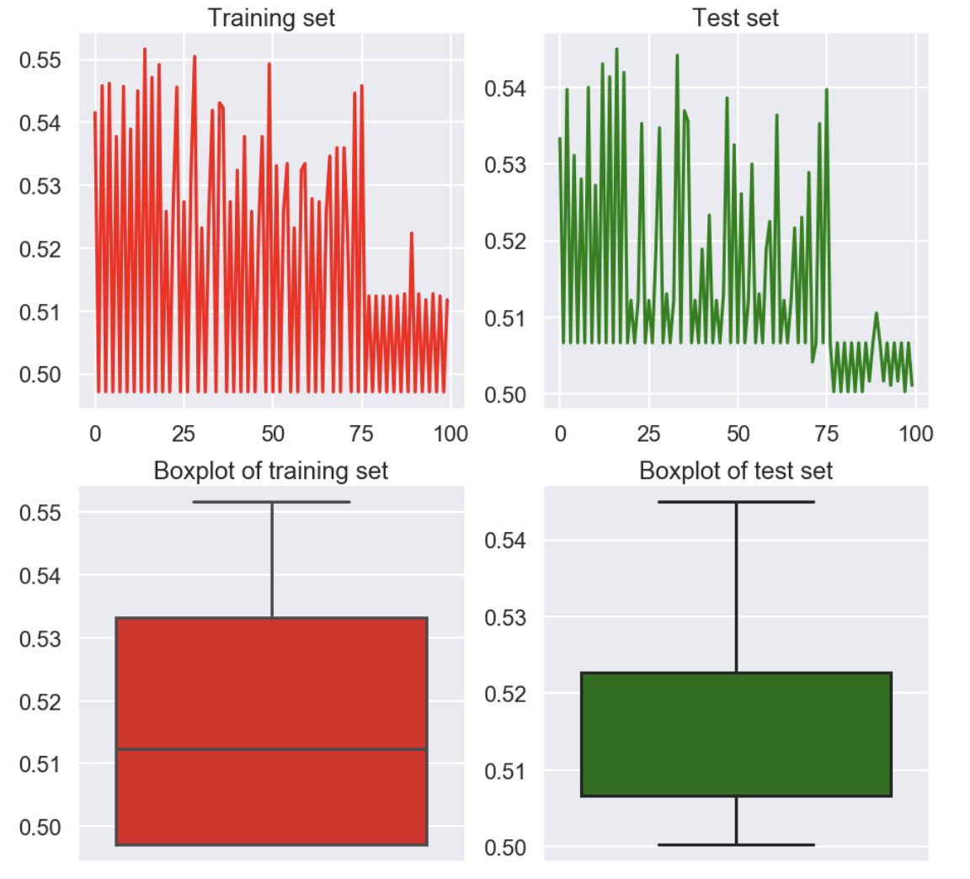
Accuracy

Slide 11
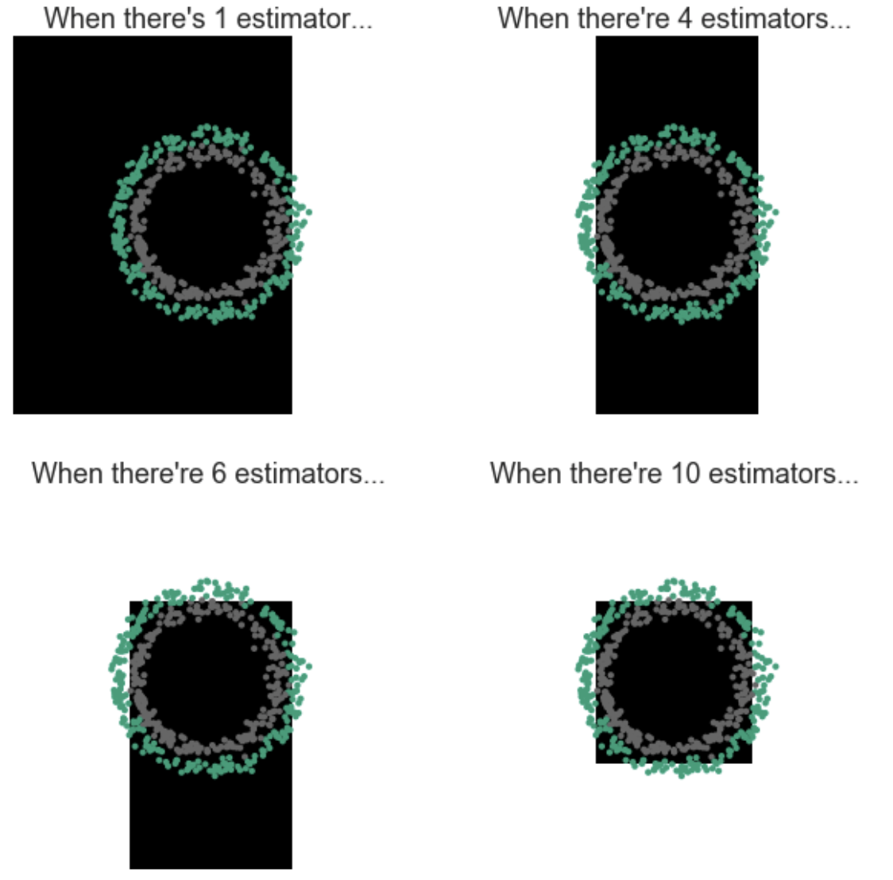
Decision Boundary

Slide 12
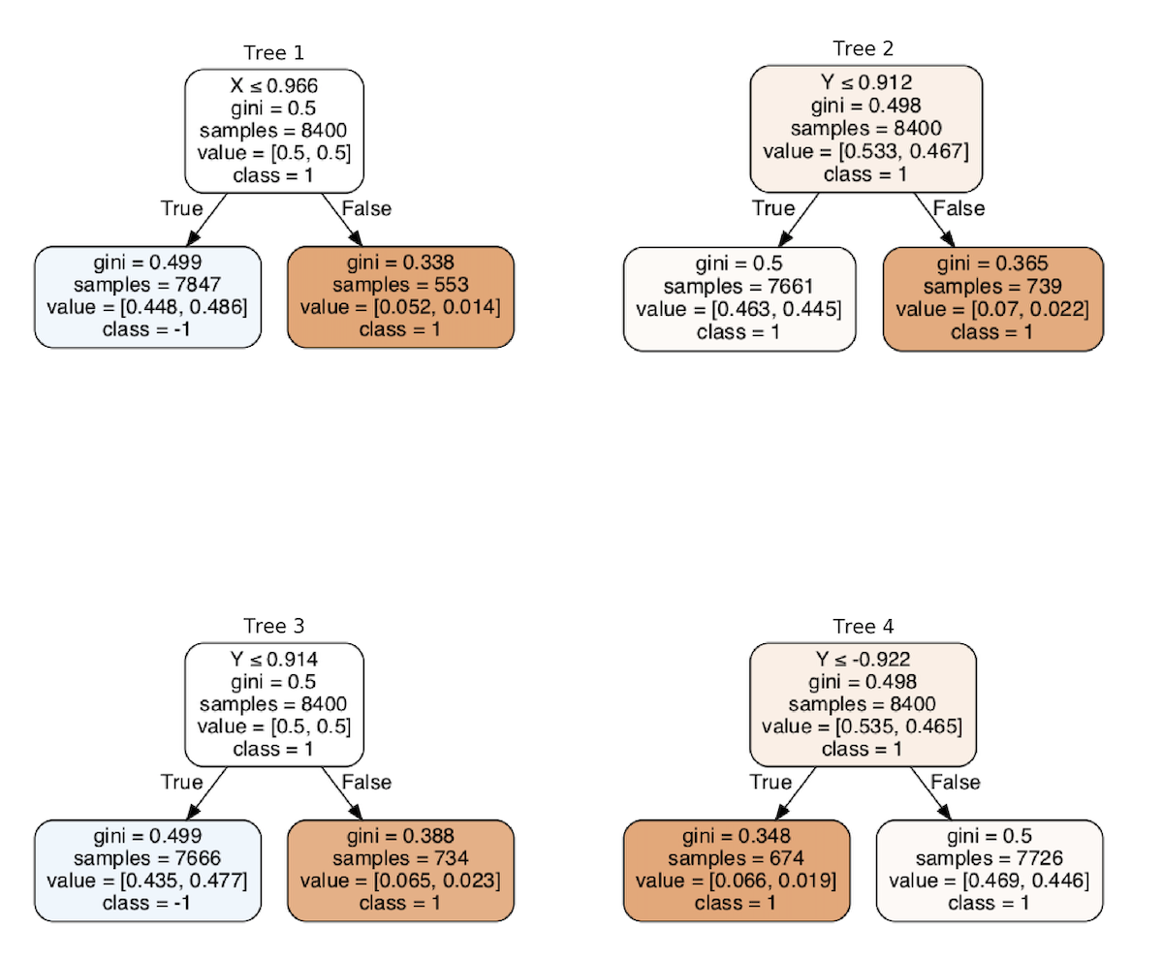
Small Detail

Slide 13
3.Problems

Slide 14
Problem 1

Slide 15
Problem 2

Slide 16

Problem 3
Multi-Class Adaboost

Slide 17
The End

